Slide 1
Hackathon Presentation
Team ID: bharathsurampudi_f1d8
Team Members: Bharath Naga Chandra, Mohammed Yunus, Hari Haran
23 September 2018
Team ID bharathsurampudi_f1d8
BHARATH NAGA CHANDRA
Mohammed Yunus
HARI HARAN

Slide 2
Objective
We are developing an Activity that takes tabular data in PDF to data table to help enterprise business to leverage their data in PDF to support there ERP, CRM or Big Data initiatives

Slide 3
Problem Statement
Large volume of unused data
Manual data entry process
Prone to errors
Time consuming
Expensive

Slide 4

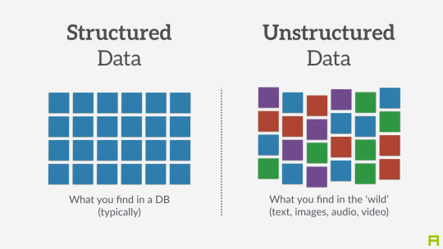









Business Scenario
Data that needs lot of effort to make it useful
Useful Data
Meaningful data in excel, csv, json, etc
Enterprise ready data

Slide 5
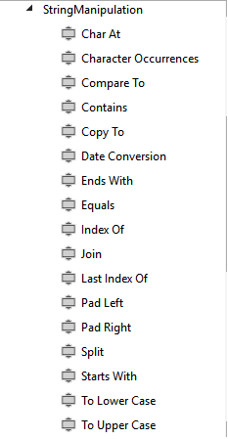

String Manipulation: Our contribution

Slide 6
String Manipulation: Why?
https://forum.uipath.com/t/string-manipulation/37813
https://forum.uipath.com/t/excel-file-string-manipulation/3639
https://stackoverflow.com/questions/49388684/how-to-use-not-contains-function-in-string-in-uipath
https://forum.uipath.com/t/complex-string-manipulation/29850
https://forum.uipath.com/t/how-to-print-some-words-from-a-paragraph-which-is-stored-in-variable/11686
https://forum.uipath.com/t/how-to-split-a-string/2098
https://forum.uipath.com/t/trim-or-substring/3705
https://forum.uipath.com/t/how-to-perform-string-operations-on-a-selected-rowitem-using-foreach-loop-datatable/2013
https://forum.uipath.com/t/string-type-to-datetime-type-conversion-format-exception/37070
https://12thwonder.com/get-year-month-day-string-variable-containing-date-yyyymmdd-format-uipath/
https://forum.uipath.com/t/how-can-a-string-variable-called-mystring-be-converted-to-an-all-capitals-representation-for-future-use/35016/2

